Slide 1


Virtual Reality-Ontology with Protégé
Realised by :
Belanez Hamdi
Jebali Wafa
Professor in charge :
Bayoudhi Leila

Slide 2
Table of contents
01
02
03
05
06
07
Introduction
RDFS Ontology
Protégé
04
OWL2
SPARQL
SWRL
07
08
09
SHACL
Conclusion
1
Visual Representation

Slide 3
01
Introduction

Slide 4
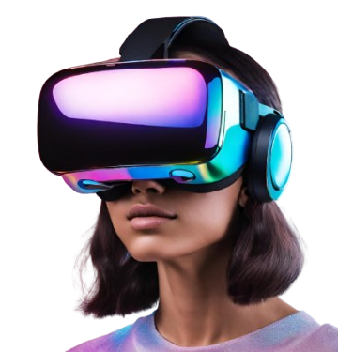

INTRODUCTION
Virtual Reality
"Virtual reality (VR) refers to the simulation of a physical presence in a virtual environment generated by computer systems."
Ontologies in VR
Ontologies are key to structuring knowledge representation.
They help represent entities, relationships, and behaviors in VR systems.
Objective of the Project
Build a Virtual Reality Ontology using Protégé.
Represent concepts like VR environments, avatars, users, interactions, and other relevant properties.
3

Slide 5
02
RDFS Ontology

Slide 6
RDFS Ontology
What is RDFS (Resource Description Framework Schema)?
A semantic web language for defining simple ontologies.
Purpose of RDFS in this Project
Model the conceptual relationships between VR elements like users, avatars, and virtual worlds.
Key Terms to Define
Class: Avatar, Virtual Environment, User
Relationships: interactsWith, existsIn, represents
5

Slide 7
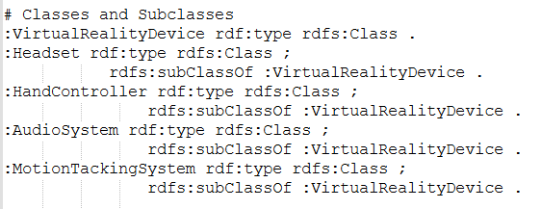
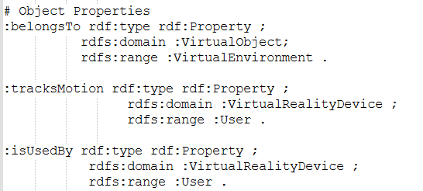
RDFS Ontology
Create Classes and Subclasses
Create Object Proprieties
6

Slide 8

03
Protégé

Slide 9
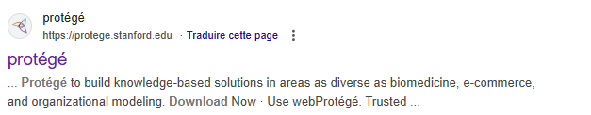
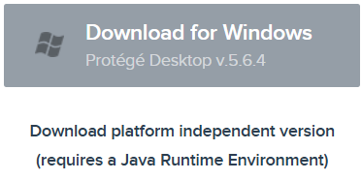

Protégé installation
Step 1
Step 3
Step 2
Step 4
Step 5
Step 6
8

Slide 10

04
OWL2

Slide 11
OWL2
Why OWL2(Web Ontology Language 2)?
OWL2 allows reasoning about relationships and semantics in ontologies.
Key Features of OWL2
Classes, Properties, Inheritance, Constraints.
How OWL2 was used in this project
For defining relationships in the VR ontology.
Adding domain knowledge with reasoning features.
10

Slide 12
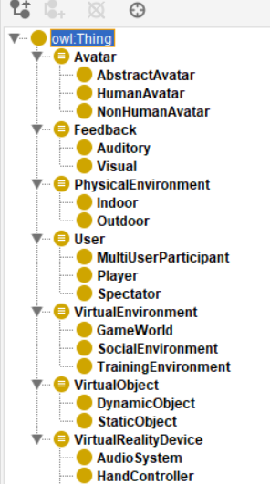
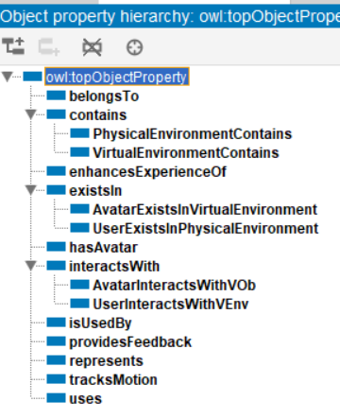
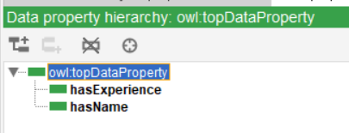
OWL2
11
Class hiearchy
object property hiearchy
data property hiearchy

Slide 13
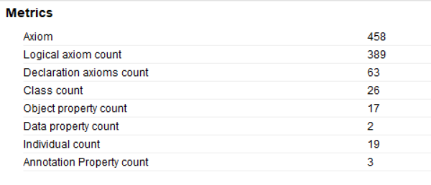
OWL2
12
ontology metrics

Slide 14

05
SPARQL

Slide 15
SPARQL Queries
What is SPARQL?
A query language for RDF data stores.
Objective with SPARQL in this Project
Query the VR ontology to analyze relationships and data patterns.
Exemple Query
SELECT ?avatar
WHERE {
?avatar a <http://example.org/virtual-reality#Avatar>
}
14

Slide 16

06
SWRL

Slide 17
SWRL Rules
What is SWRL (Semantic Web Rule Language)?
A rule-based language for expressing logical conditions in ontologies.
Application in this Project
Rules defined to enrich logical reasoning about avatars' behaviors and virtual interactions
Exemple SWRL Rule
User(?u) ∧ interactsWith(?u, ?a) → hasAvatar(?u, ?a)
16

Slide 18

07
SHACL

Slide 19
SHACL Constraints
What is SHACL (Shapes Constraint Language)?
SHACL (Shapes Constraint Language) allows you to validate RDF data against predefined constraints.
Objectif in the VR Ontology
Define and enforce logical constraints on user-avatar interactions and virtual objects' attributes.
@prefix sh: <http://www.w3.org/ns/shacl#> . @prefix vr: <http://example.org/vr#> . vr:UserShape a sh:NodeShape ;
sh:targetClass vr:User ;
sh:property [
sh:path vr:hasID ;
sh:datatype xsd:string ;
sh:uniqueLang true ;
sh:minCount 1 ; ] ,
Exemple Constraint
SHACL
18

Slide 20

08
Visual Representation

Slide 21
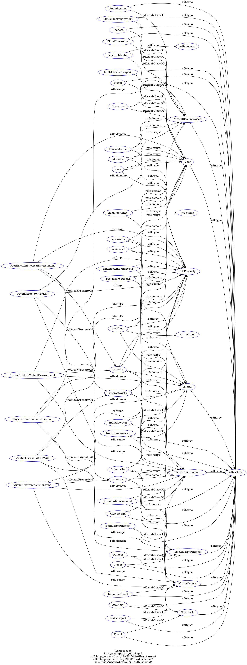
Visual Representation
20
rdfs graph

Slide 22
Visual Representation
20
Onto graph

Slide 23

09
Conclusion

Slide 24
Conclusion
this project successfully demonstrated the development of a Virtual Reality Ontology using Protégé, leveraging advanced semantic web technologies such as RDFS, OWL2, SPARQL, SWRL, and SHACL. By structuring the relationships between entities like users, avatars, and virtual environments, the ontology provides a foundational framework for understanding and modeling interactions within virtual worlds. These tools not only facilitated logical reasoning and querying but also ensured data consistency and validation. This work highlights the potential of ontologies to enhance knowledge representation in complex domains like Virtual Reality, paving the way for future advancements in VR-based systems and applications.
22

Slide 25
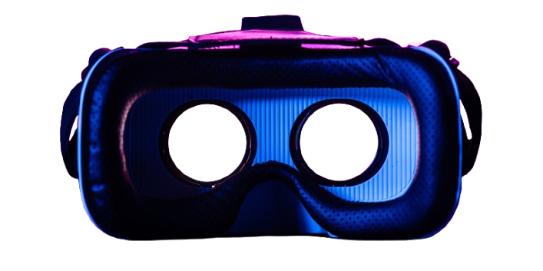

Thanks
For your Attention!

